Slide 1
LOVELY PROFESSIONAL UNIVERSITY
UI-UX(IXD802)
Name: Deepali Mahar
Reg No: 12112535
Section: KO364
Roll No: RKO64A12

Slide 2
Table of Contents
Problem Statement
Objective and Target Audience
Mind Mapping
Case Study
Competitive Analysis
Surveys
Interviews
User Persona’s
Empathy Mapping
Insights and Inferences
Redesign Design Brief
4
6
8
10
12
14
18
22
26
2832
02

Slide 3
Table of Contents
5 W, 1 H
Scamper
Scenario Building
Final Idea
Information Architecture
User Flow
Low Fidelity Wireframe
High Fidelity Wireframe
Style Guide
Mood Board
Final UI Screens
34
36
40
42
44
48
51
53
60
62
64
02

Slide 4
1
Problem
Statement

Slide 5


Problem Statement
Our University's event system is currently struggling. It's spread out and disorganized, making it hard for students to find and attend events, which hurts participation and our ability to show the positive impact we have on campus life. Planning events is slow and messy due to outdated paper processes and poor communication, making it hard to ensure their success or gauge student interest. Finding the right venues and keeping everyone informed is also challenging. This broken system hides our great work from students and leaves them uninformed.
04

Slide 6
2
Objective and Target Audience

Slide 7



Objective and Target Audience
Objective
Unify & Streamline: Create a central hub for all event information, accessible and transparent for all students.
Amplify Communication: Enhance two-way communication, ensuring students are informed, engaged, and connected.
Boost Student Engagement: Prioritize inclusivity and accessibility, facilitating active student participation in campus activities.
Target audience
Students and faculties of Lovely Professional University
06

Slide 8
3
Mind-
Mapping

Slide 9
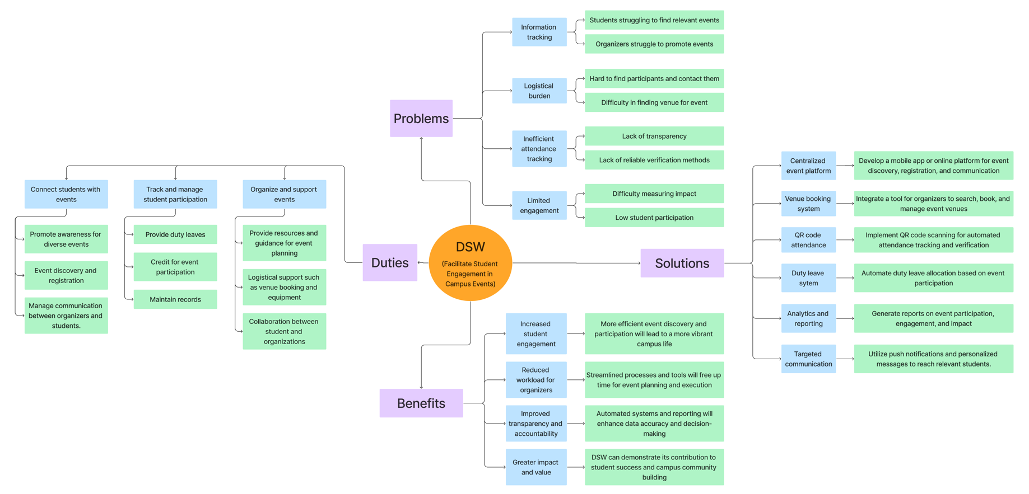
08

Slide 10
4
Case
Study

Slide 11
Situation analysis of students’ welfare services in universities in South-Western Nigeria: Implications for students’ personnel management practice
This is an article about the situation of welfare services in universities in South-Western Nigeria. It discusses the impact these services have on students’ motivation to learn. The researchers surveyed final-year undergraduate students from three faculties and a college at five public universities. They found that there was a significant relationship between the availability of welfare services and students’ perceived motivation. Students who were more satisfied with the available services also reported higher levels of motivation. The researchers recommend that universities improve their infrastructure, health care delivery systems, and security measures. They also suggest that universities provide more financial aid and create a more supportive learning environment.
09

Slide 12
5
Competitive
Analysis

Slide 13
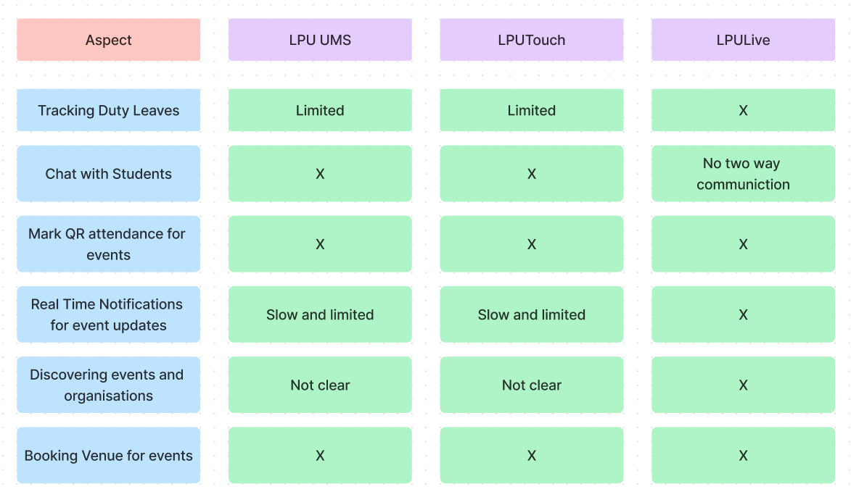

Slide 14
6
Surveys

Slide 15
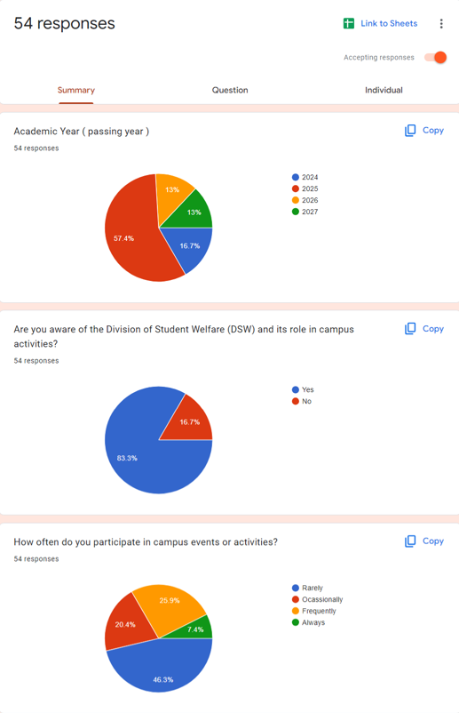
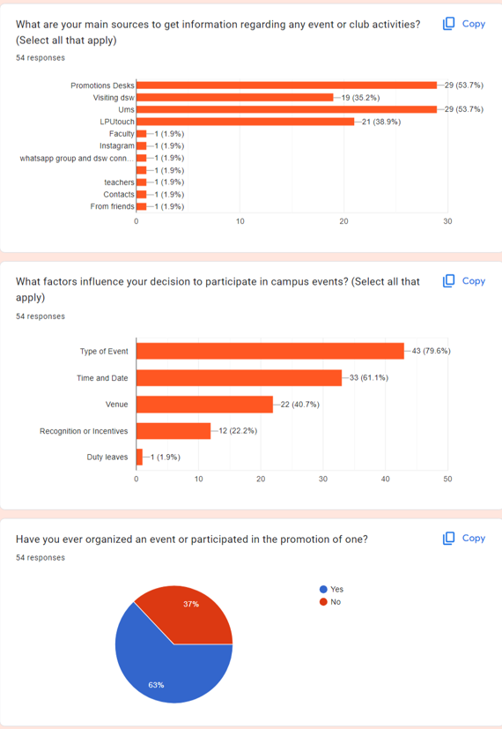

Slide 16
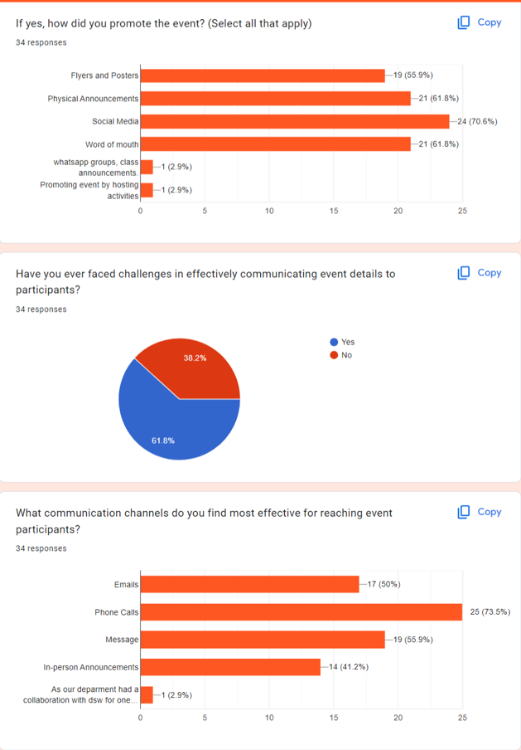
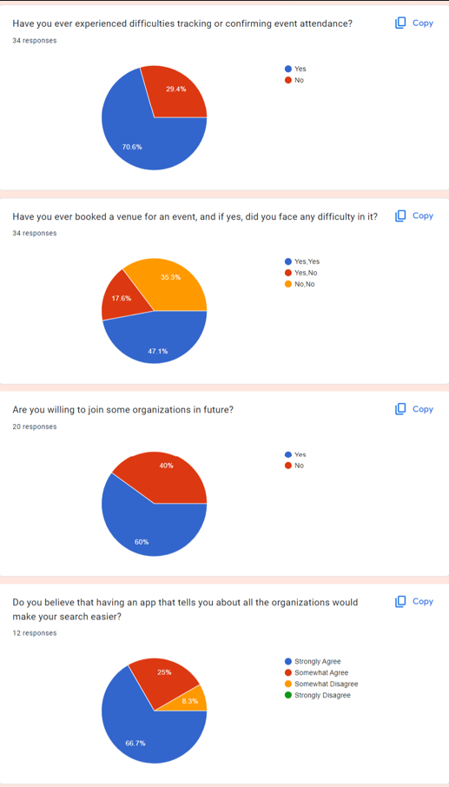

Slide 17
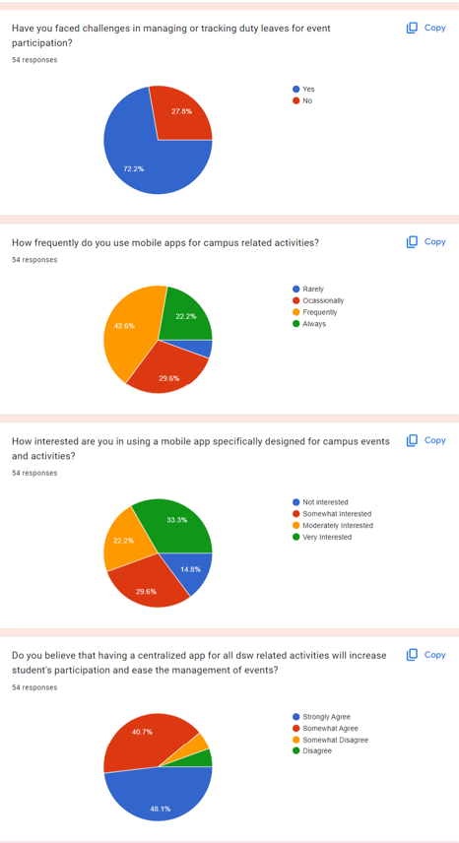
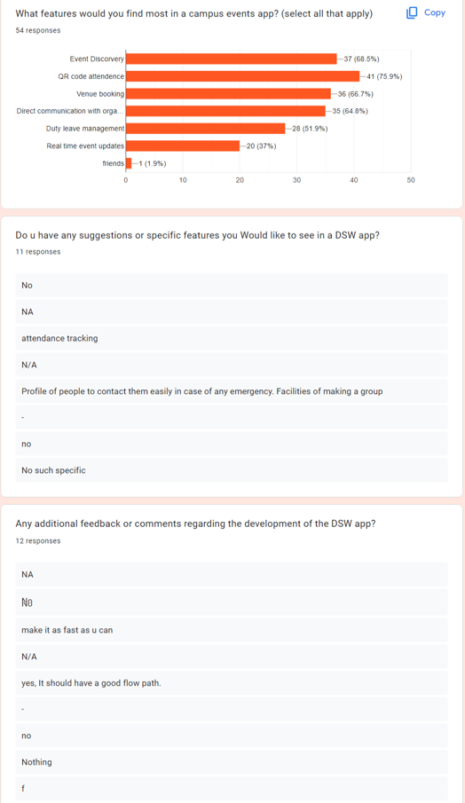

Slide 18
7
Interviews

Slide 19
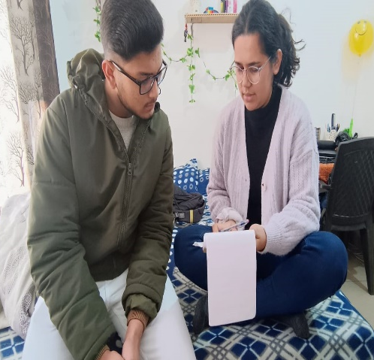
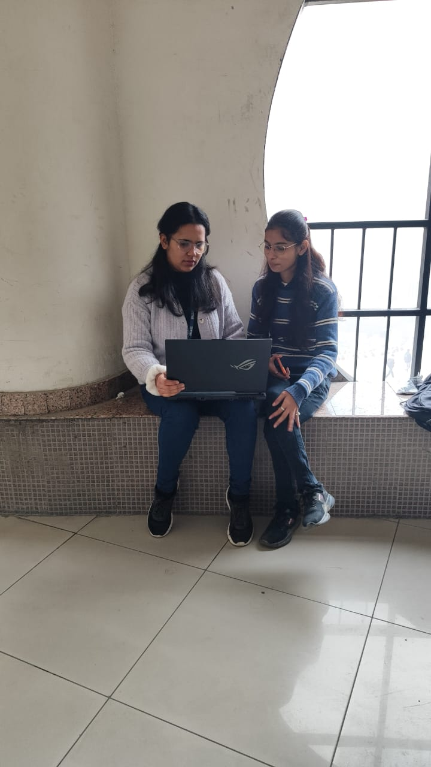
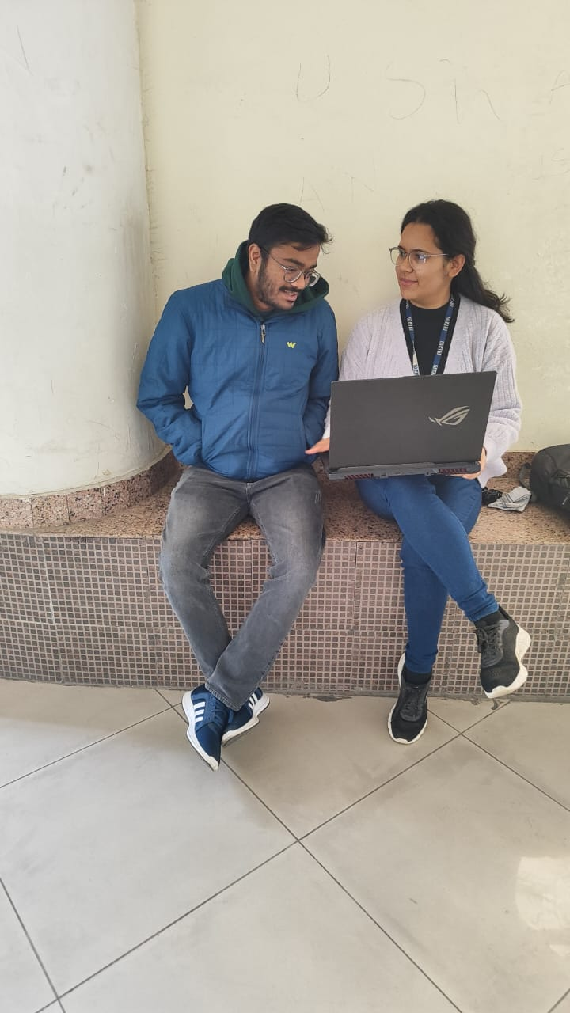
Interviews
Preetam Das
Kasish Verma
Aadi Padamvar
3rd Year CSE Student
(CEO of OASIS)
3rd Year CSE Student
3rd Year CSE Student
(Works in Placement Cell)
16

Slide 20
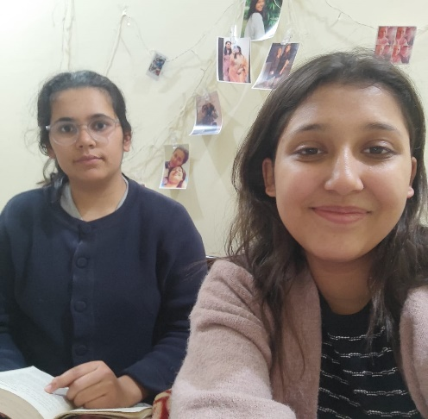
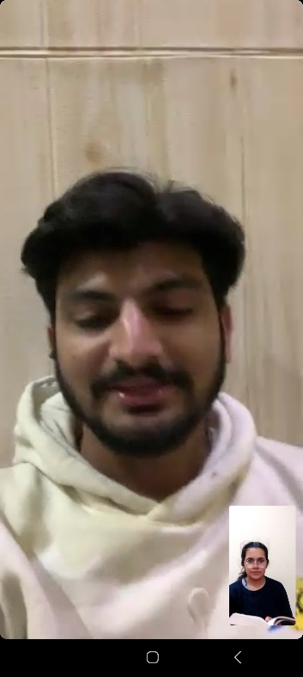
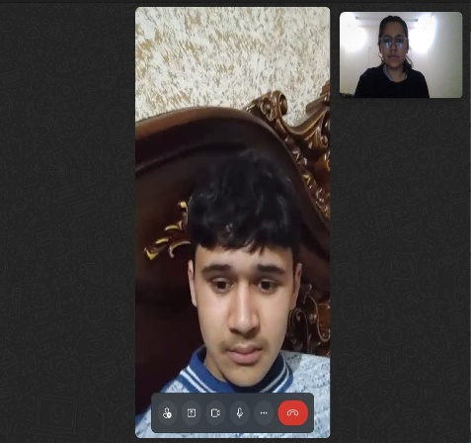
Interviews
Dhairya Mahar
Dipali Diniya
Jaydev Der
1st Year CSE Student
4th Year Architecture Student
(Worked in Annual NASA Convention)
4th Year Architecture Student
17

Slide 21
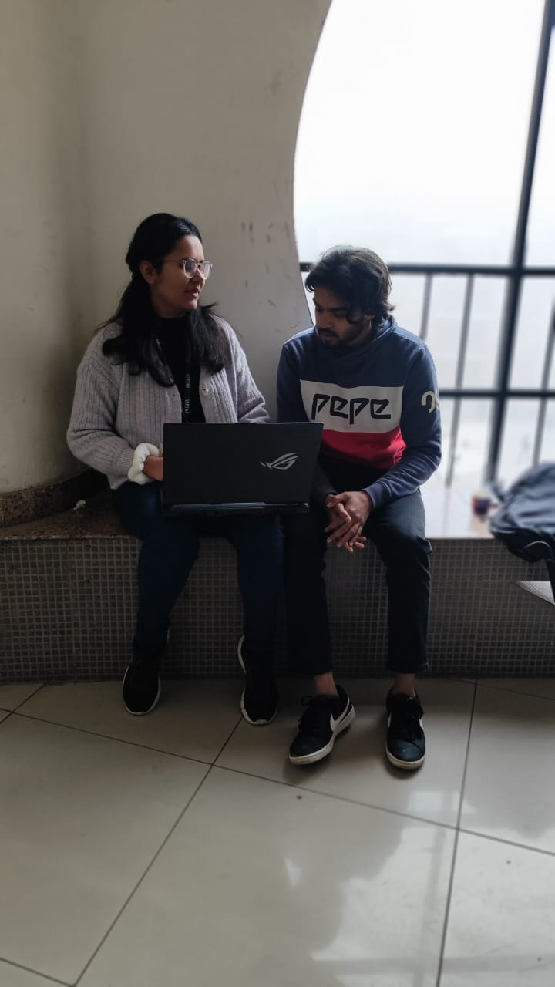
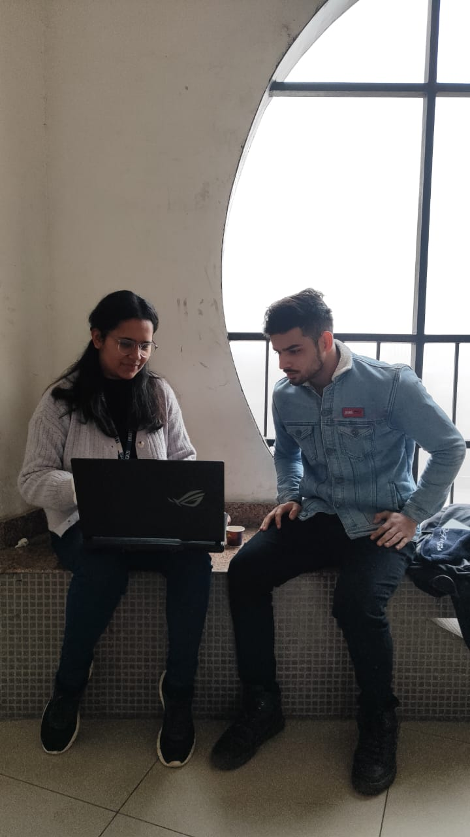
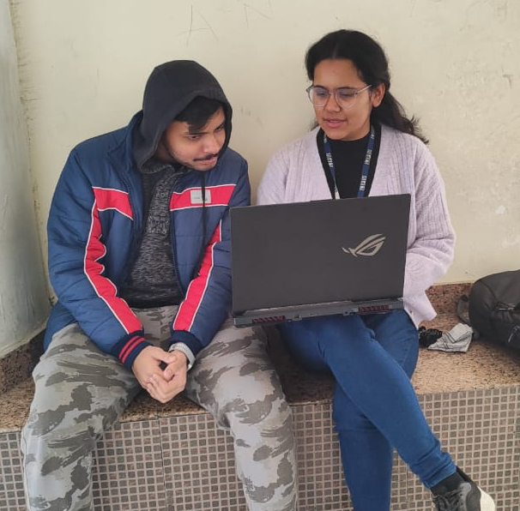
Interviews
Anirudh Sannidhi
Tanmay Mahajan
Aman Jangra
3rd Year CSE Student
(Works in Placement Cell)
3rd Year CSE Student
3rd Year CSE Student
18

Slide 22
8
User
Persona’s

Slide 23
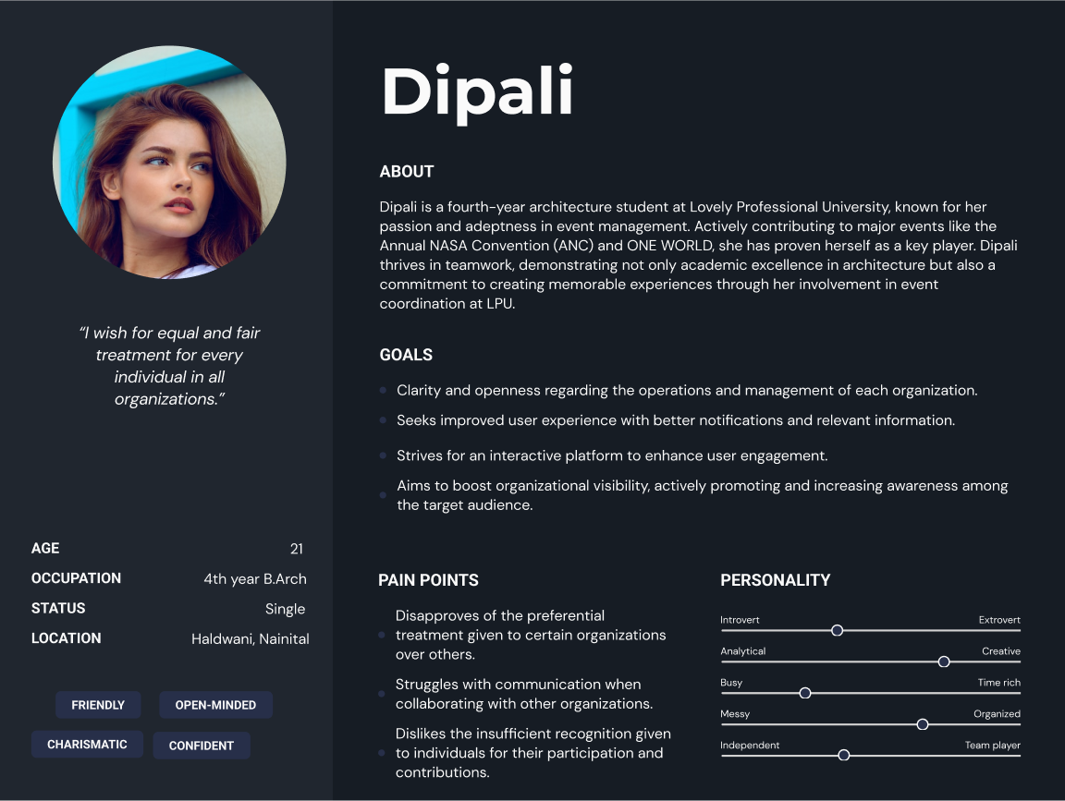
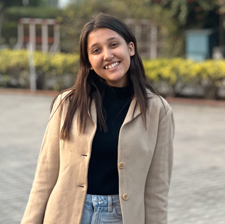

Slide 24
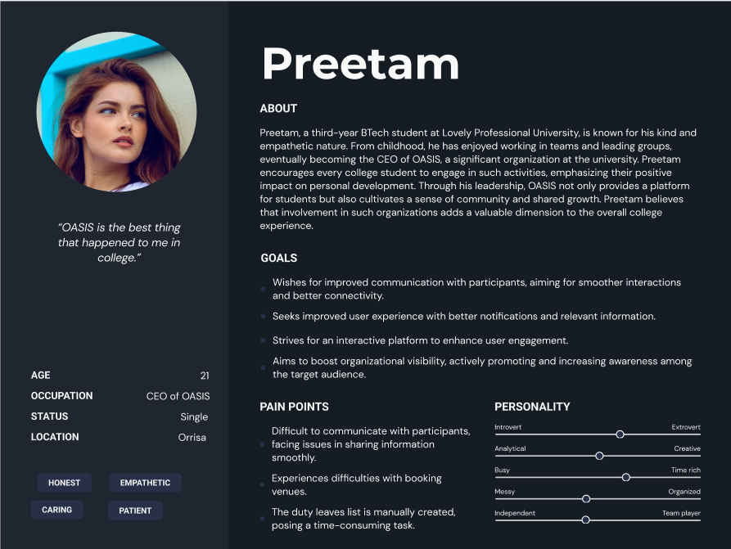
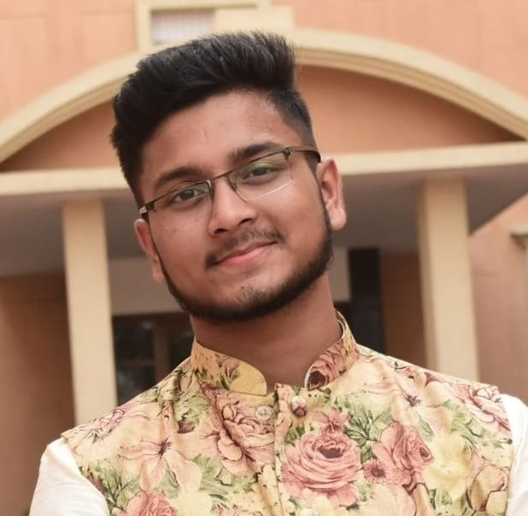

Slide 25
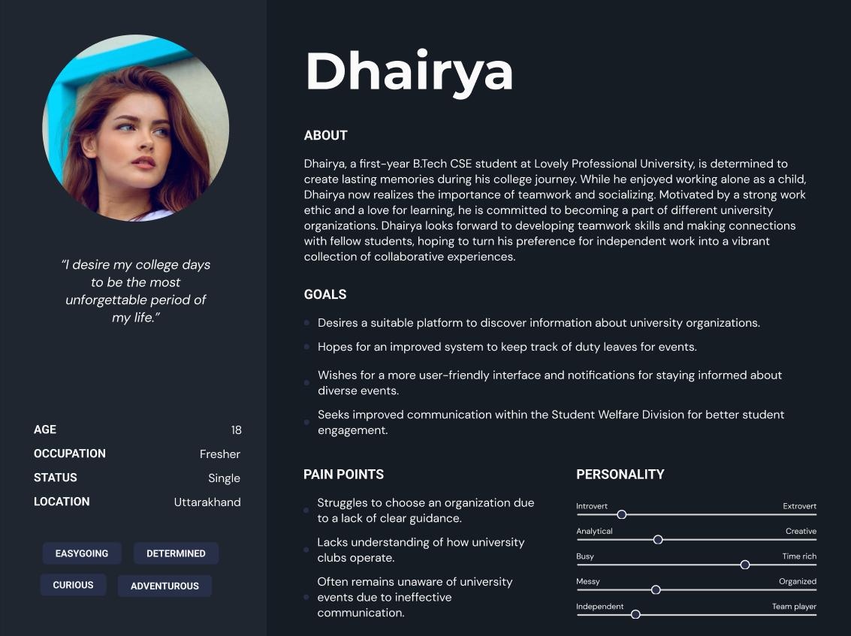
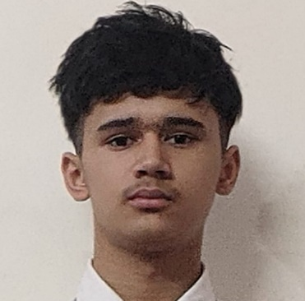

Slide 26
9
Empathy
Mapping

Slide 27
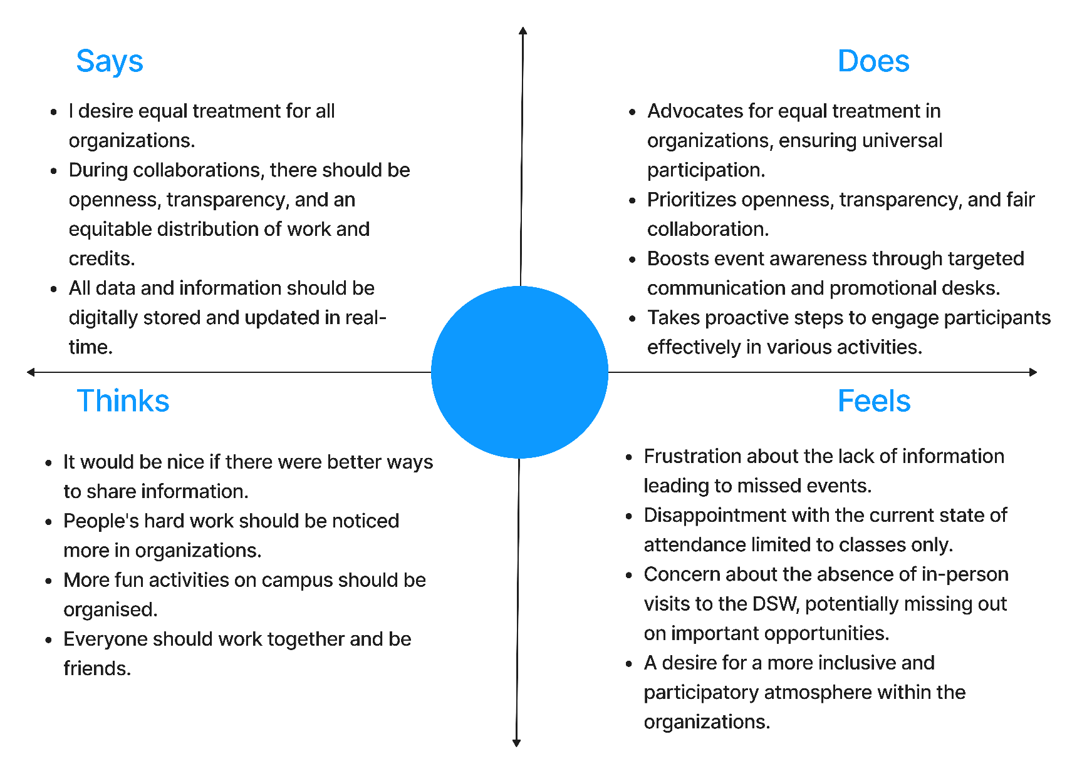

Slide 28
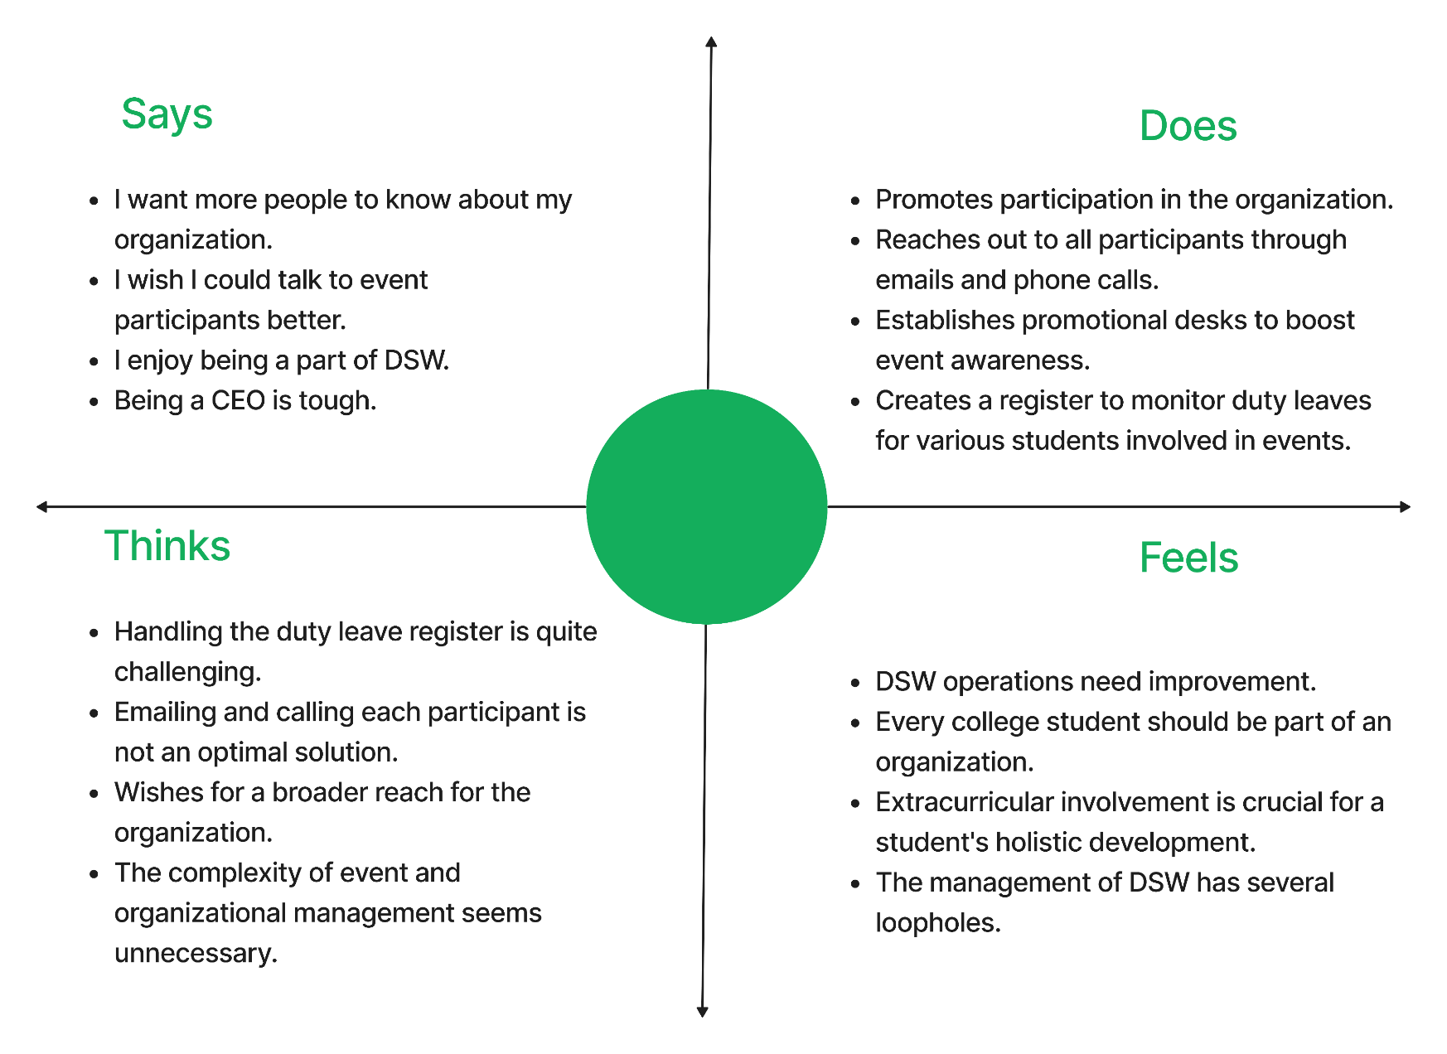


Slide 29
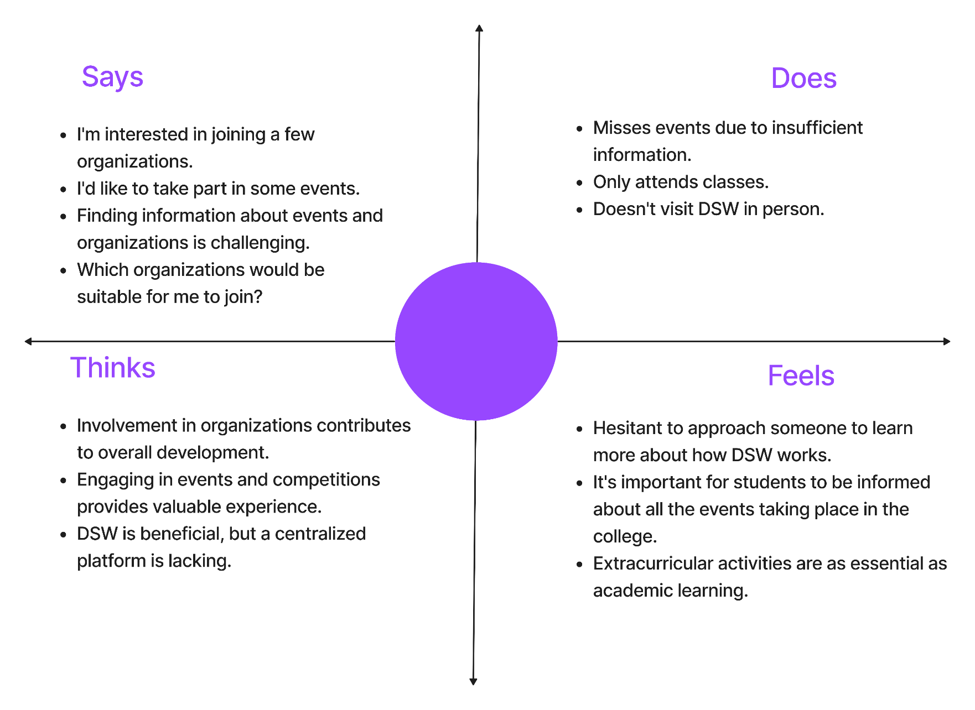


Slide 30
10
Insights and
Inferences

Slide 31
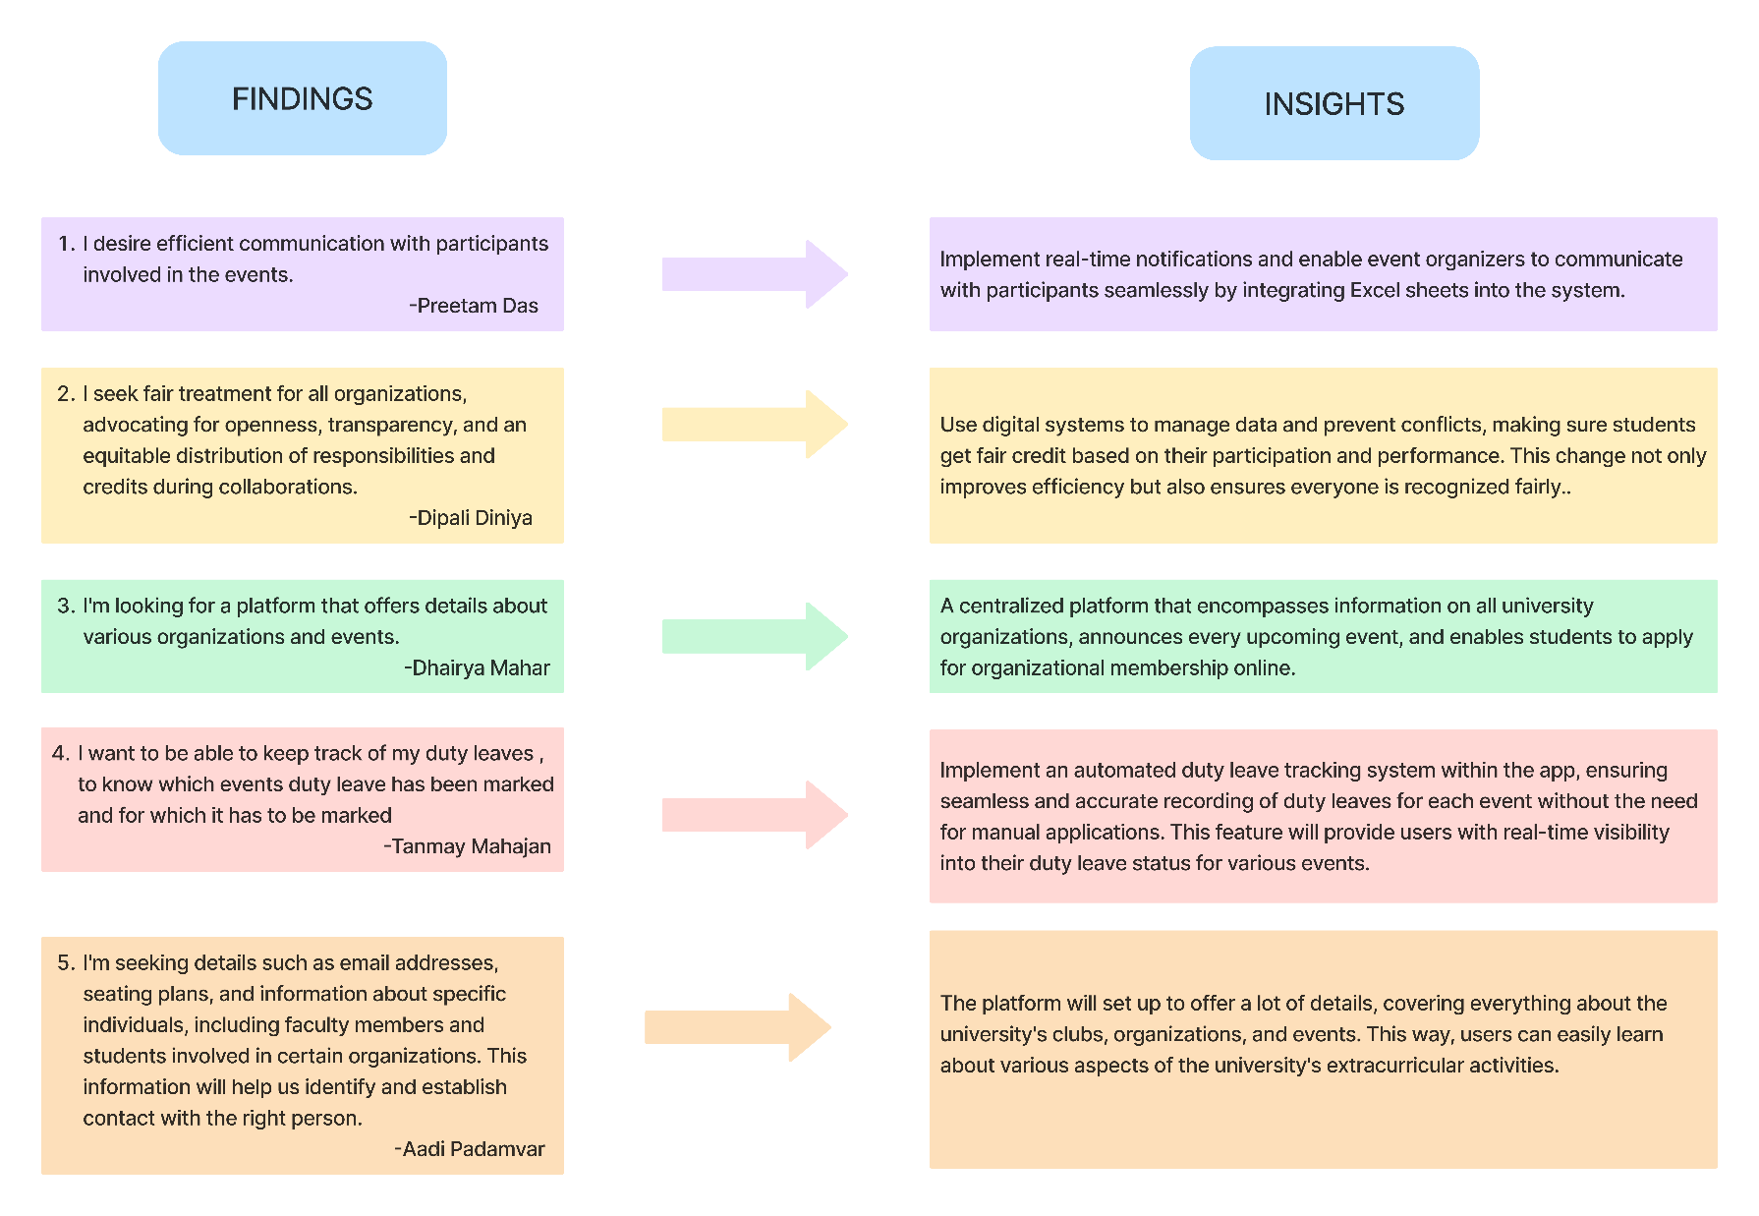

Slide 32
11
Redefine
Design Brief

Slide 33
Redesign Design Brief
Overview
Creating a central hub to simplify university life by providing easy access to essential information, fostering communication, and enhancing engagement.
Objective
Create a centralized platform through a Departmental Event Organizer App to streamline event management, enhance communication, and foster increased student engagement in campus activities.
Target audience
Students and faculties of Lovely Professional University
30

Slide 34
12
5 W’s
& 1 H

Slide 35
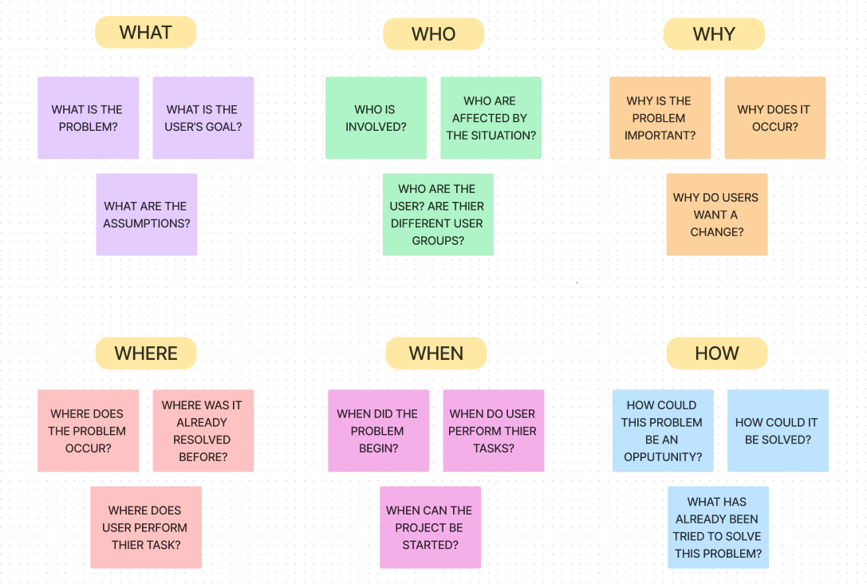

Slide 36
13
Scamper

Slide 37
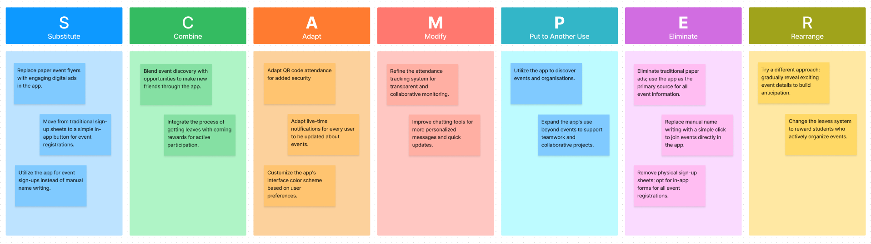

Slide 38
14
Scenario
Building

Slide 39
Scenario 1
“Quick Event Join”
Background:
Lisa, a student, receives a notification on the DSW app about an upcoming poetry reading event happening in the courtyard.
Scenario:
Lisa opens the app to explore events.
She spots a poetry reading event and clicks "Join" with a single tap.
The app sends her updates regarding time and venue of the event.
37

Slide 40
Scenario 2
“Club Meeting Reminder”
Background:
Jake, a member of the Photography Club, is reminded of the weekly club meeting using the DSW app.
Scenario:
Jake receives a push notification about the Photography Club meeting.
He opens the app, checks the notification, and sees the agenda.
During the meeting, he discusses upcoming events using the in-app chat.
38

Slide 41
Scenario 3
“Virtual Workshop”
Background:
Emily signed up for a workshop, and the venue changed to virtual due to unexpected circumstances.
Scenario:
Emily receives a notification about the venue change to virtual.
She clicks the provided link in the app for the virtual session.
During the workshop, she engages with other participants using the in-app chat.
39

Slide 42
15
Final
Idea

Slide 43
Goal:
Facilitate vibrant campus life by connecting students seamlessly with events and activities
User-Friendly Event Hub:
Intuitive app for effortless event discovery, registration, and communication.
Personalized event suggestions based on user interests.
Efficient Organizer Tools:
Streamlined event creation, management, and budgeting.
Digital venue booking for hassle-free event execution.
Engaging Attendance Tracking:
Secure QR code scanning for accurate attendance.
Automated duty leaves and leaderboards for active participants.
Dynamic Communication Platform:
Real-time updates through push notifications and live feeds.
Collaboration tools for effective communication among student clubs.
Benefits
Increased student participation and engagement.
Empowered organizers with efficient tools.
Transparent data for informed decision-making.
Fostering a thriving, connected campus community.
Key
Features
Target Audience
Students and faculties of Lovely Professional University

Slide 44
16
Information
Architecture

Slide 45
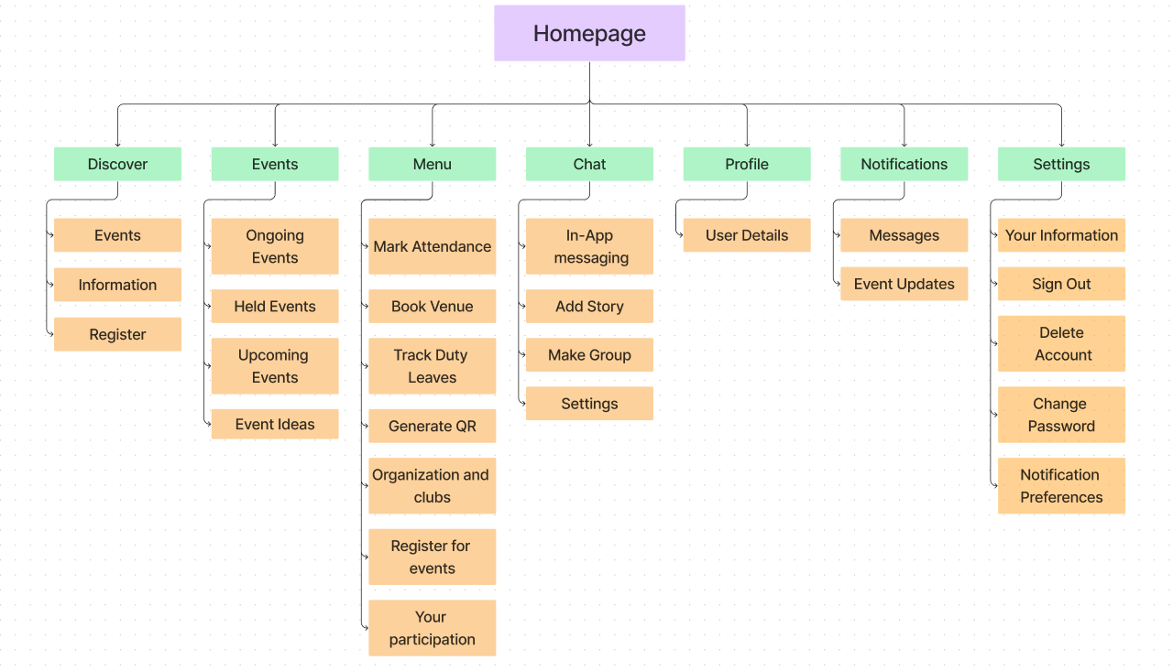

Slide 46
17
User
Flow

Slide 47
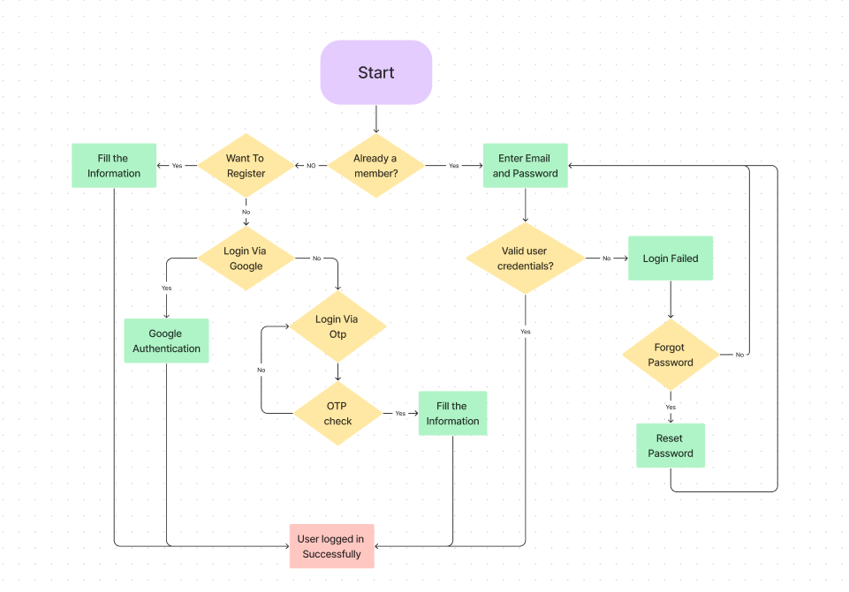
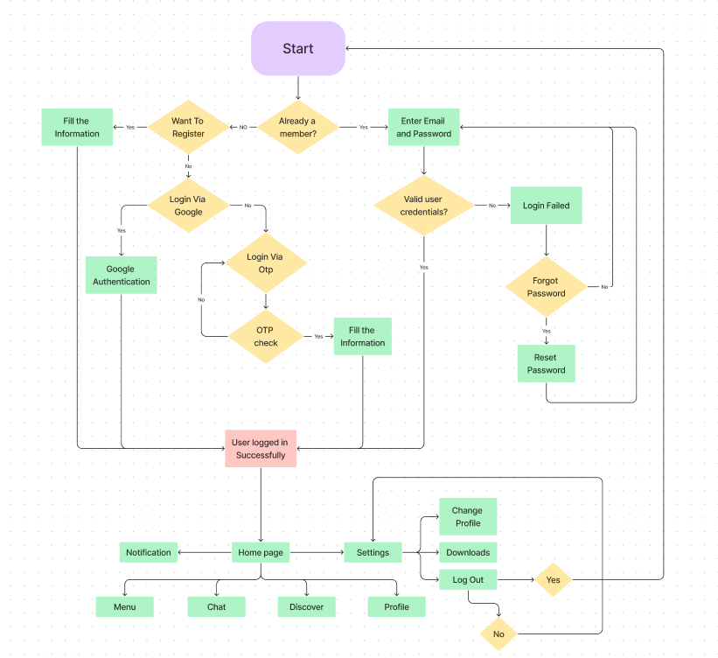
User
Login flow

Slide 48
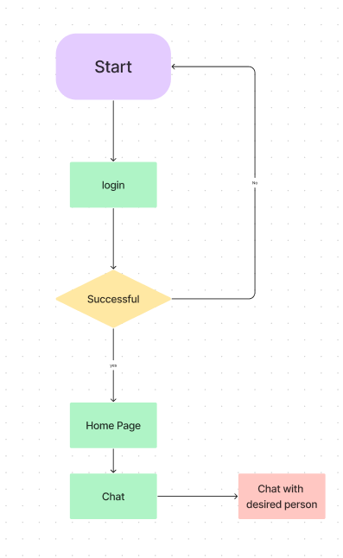
Chat User Flow

Slide 49
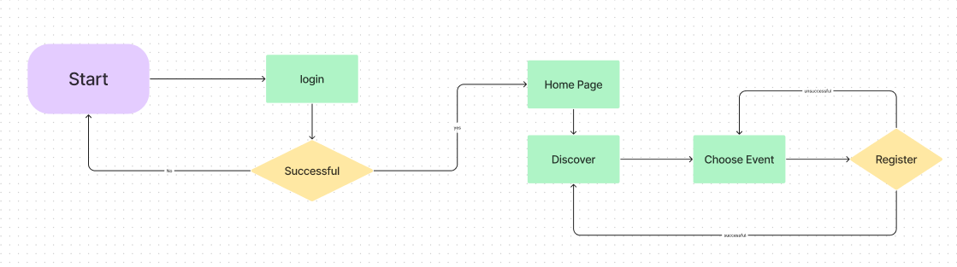
Register User Flow

Slide 50
18
Low Fidelity
Wireframe

Slide 51
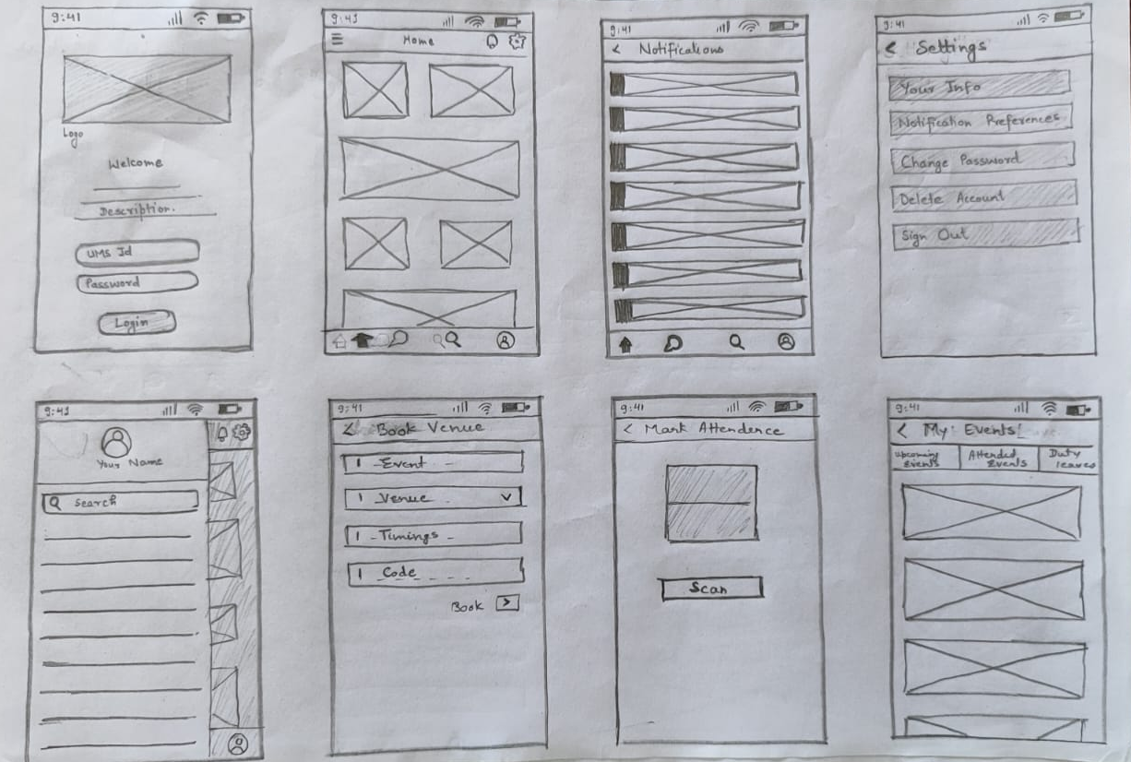

Slide 52
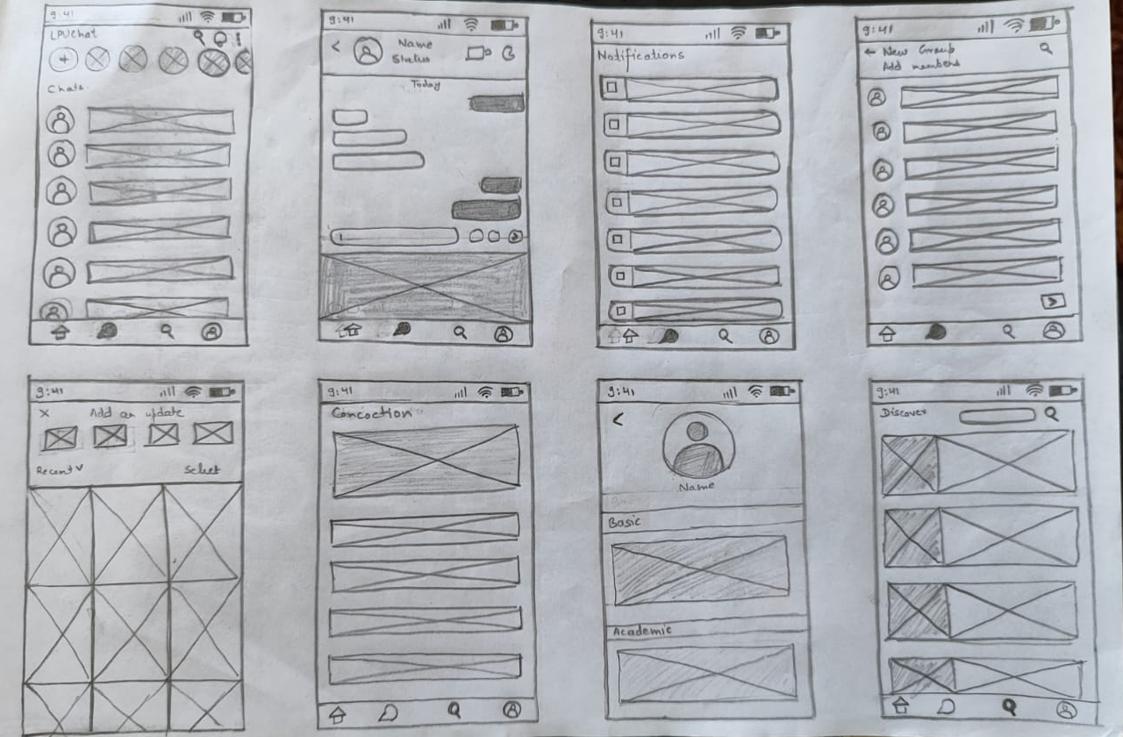

Slide 53
19
High Fidelity
Wireframe

Slide 54
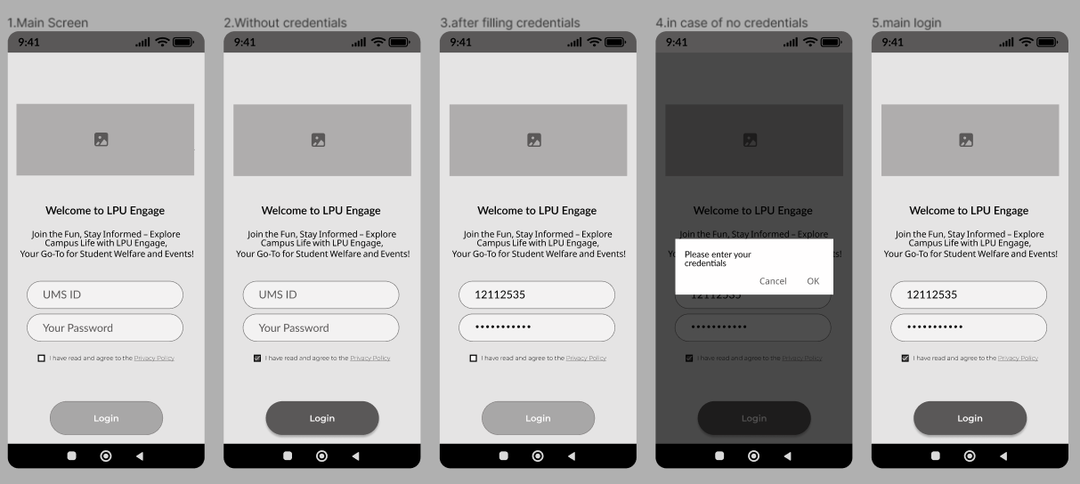

Slide 55
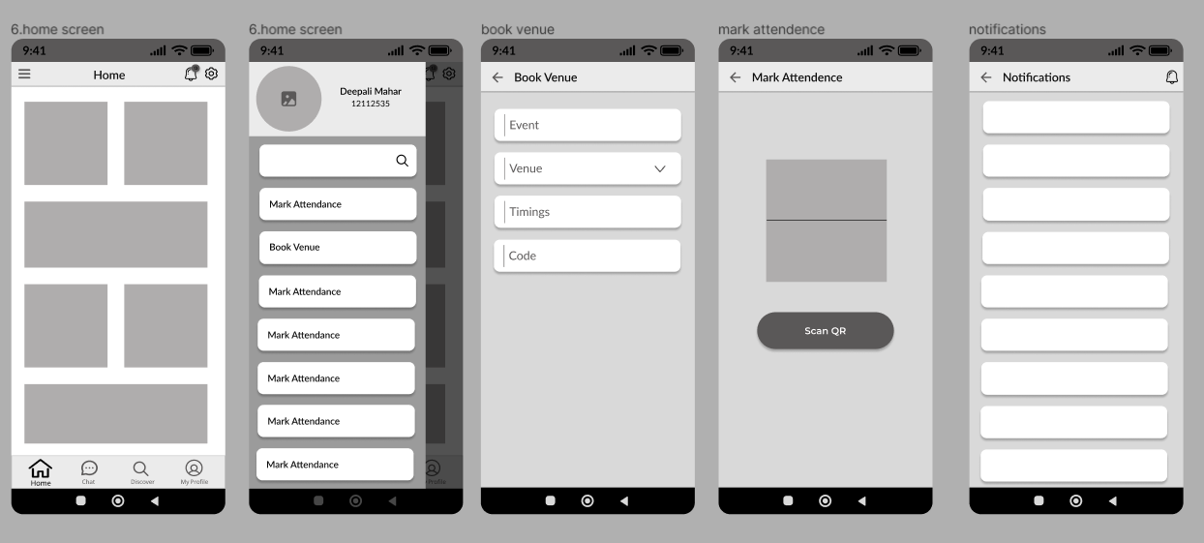

Slide 56
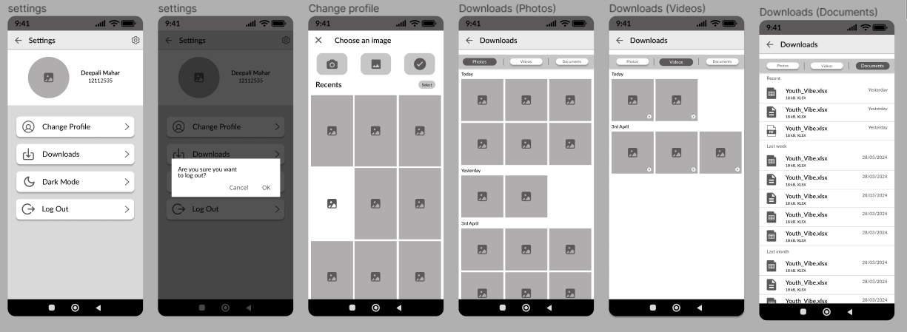

Slide 57
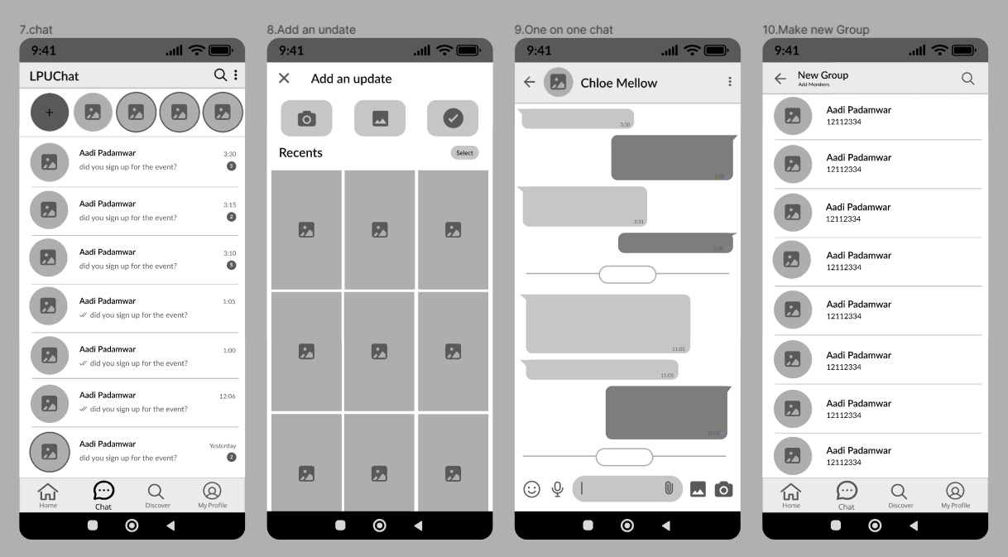

Slide 58
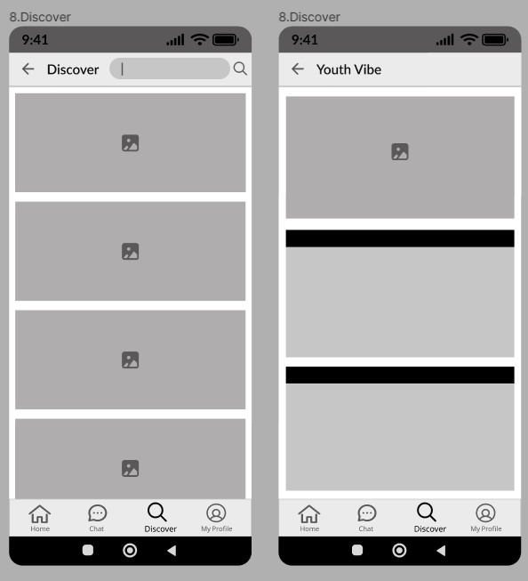
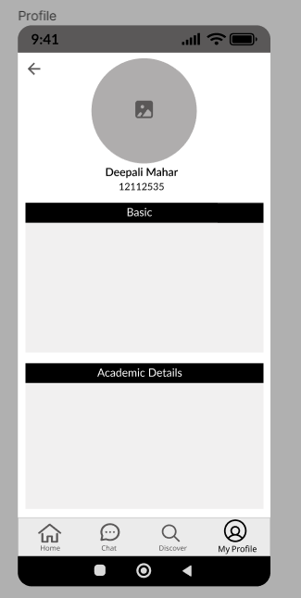

Slide 59
20
Style
Guide

Slide 60
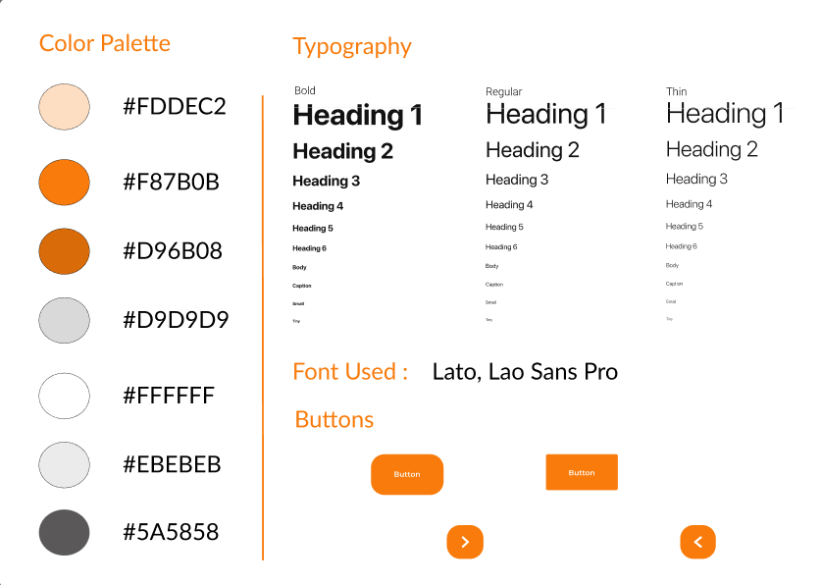

Slide 61
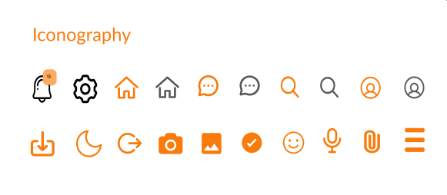

Slide 62
21
Mood
Board

Slide 63


Slide 64
22
Final UI
Screens

Slide 65
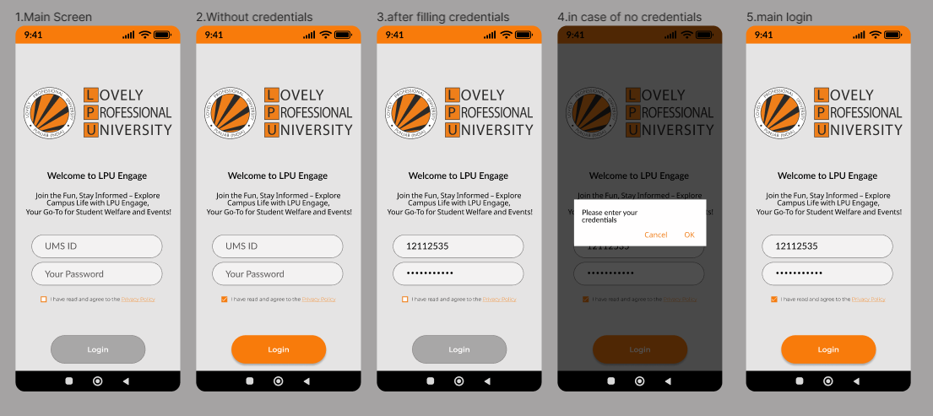

Slide 66
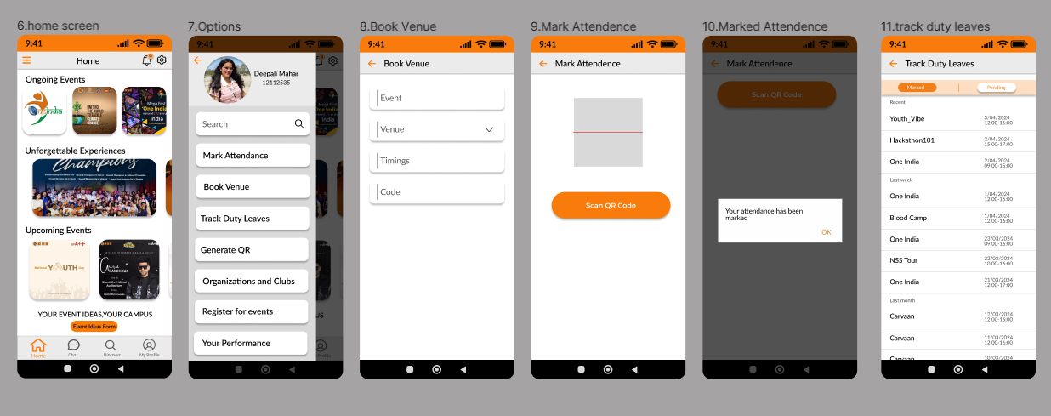

Slide 67
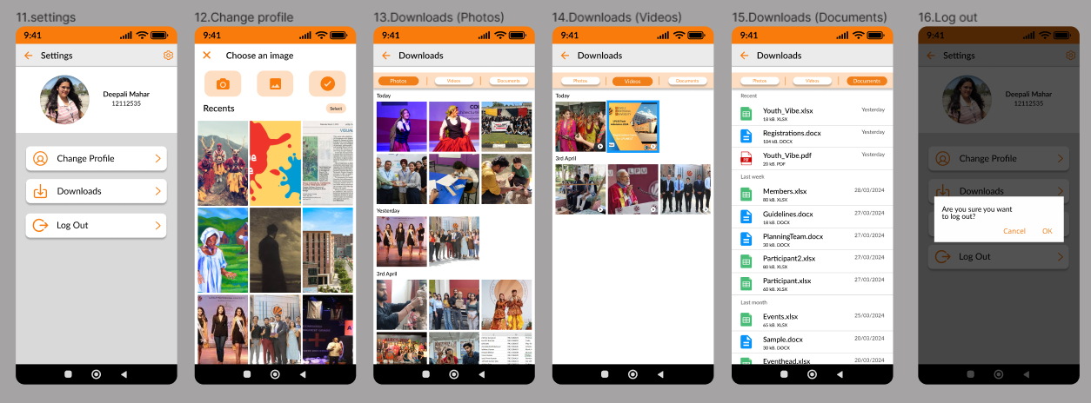

Slide 68
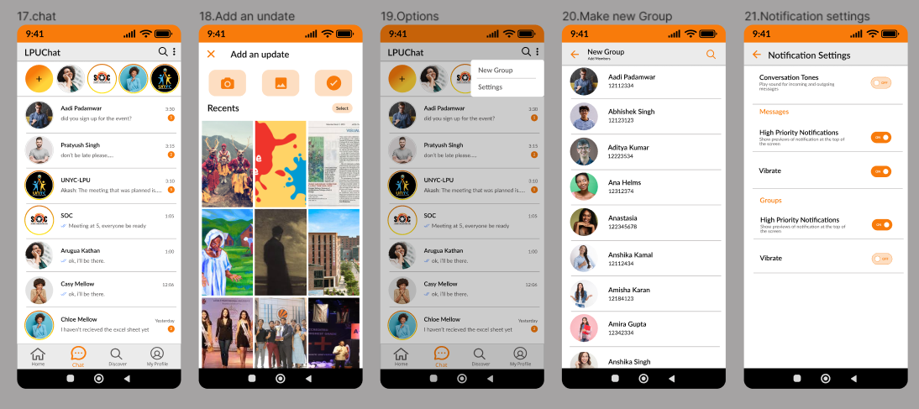

Slide 69
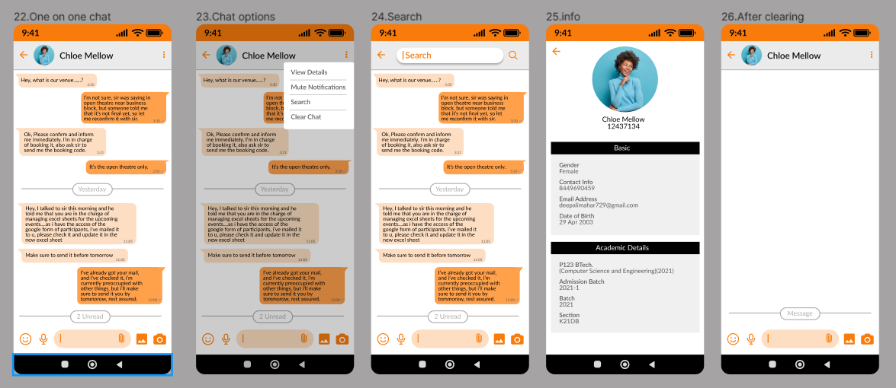

Slide 70
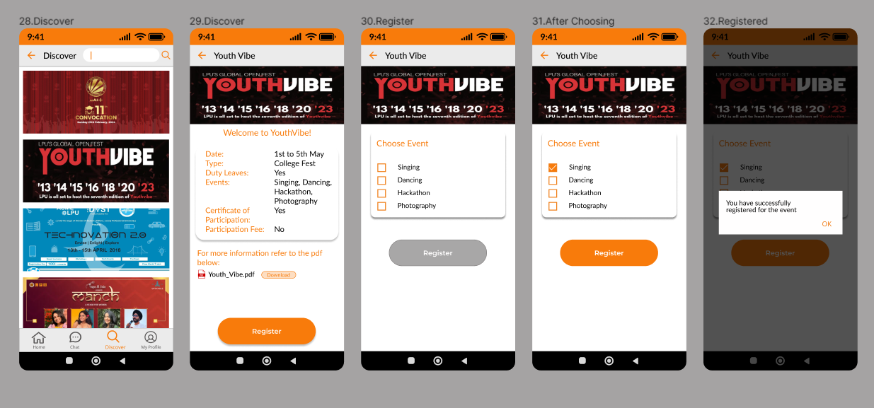


Slide 71
LOVELY PROFESSIONAL UNIVERSITY
Thank You
FIGMA LINK
https://www.figma.com/file/7pfd2EaTsNFMJ2xCnUk2df/DSW-APP?type=design&node-id=0%3A1&mode=design&t=Oh9kl1QjYxO41MkN-1

